Slide 1
The Housing We Need
Key points from the Rod Stevens housing report commissioned by the Town of Chapel Hill

Slide 2


Who drives demand?
UNC students do not drive the demand for housing in Chapel Hill. Jobs do.
Daily commuting tides: inbound to UNC vs. outbound to RTP jobs
Highest jobs to housing ratio in region

Slide 3


Whose needs are met by our housing stock?
Undergraduate students
Young single professionals (mid 20’s to low 30’s)
Under 80% AMI and low-income
First-time homeowners
Families with young children
Divorced parents (especially within walk/bike distance of school)
Empty nesters who want to downsize
Seniors
*The Area Median Income (AMI) is $84,300
(Fannie Mae AMI Lookup Tool)
80% AMI = $67,440

Slide 4
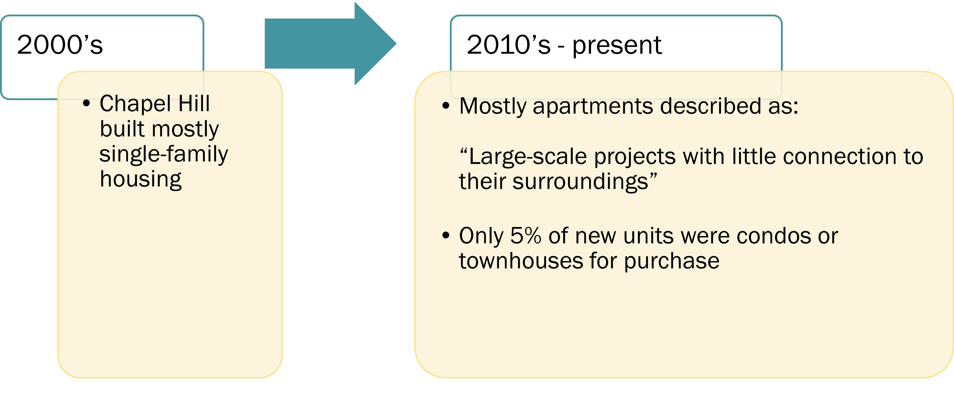


We’ve been building out of balance.

Slide 5

Much of the new development in Chapel Hill is high-rent apartments targeted at young professionals who are not yet ready to buy, many of whom work [elsewhere].
When [they] buy, they will probably choose lower-cost houses closer to their work, and Chapel Hill will lose much of that talent.

Slide 6
How can we achieve the housing we need?
What we’re doing:
Planning project-by-project with
no comprehensive vision
Examples: Berkshire, Aura, Park
What we need to do:
Creating neighborhoods; neighborhood area planning
Examples: Southern Village, Meadowmont
Opportunities: Obey Creek, White Oak, Greene Tract

Slide 7
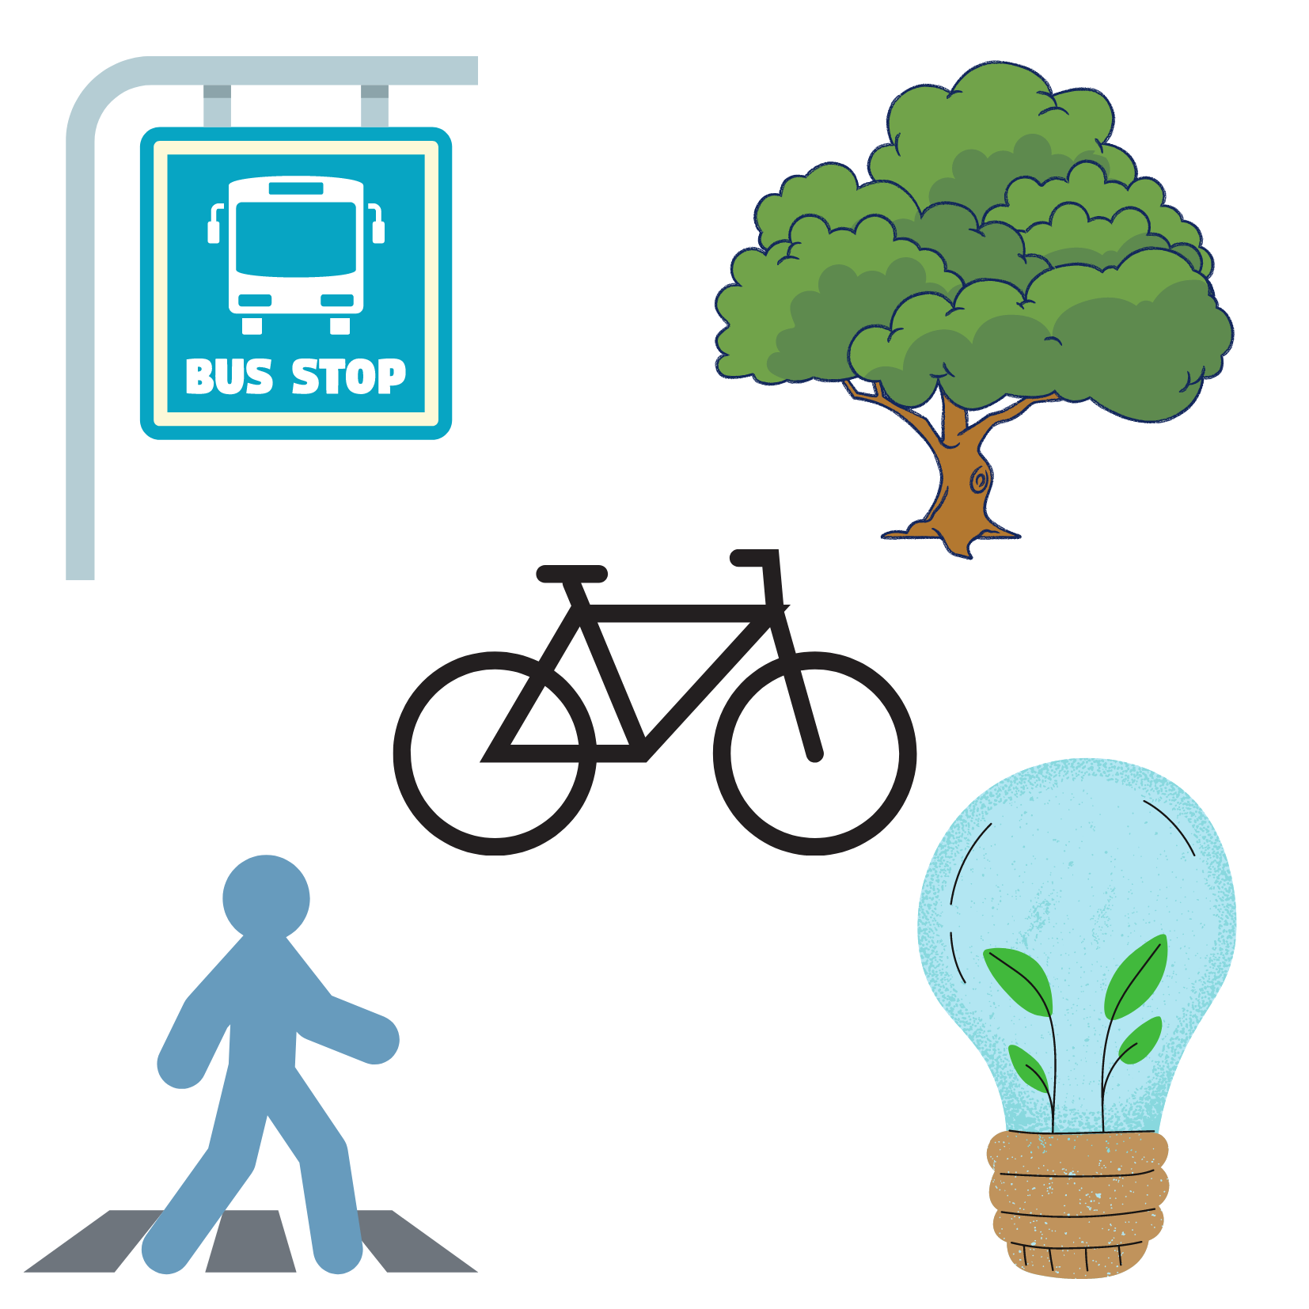
Require and incorporate community engagement and values
Open/green space, parks
Mature trees
Walking, biking, rolling friendly
Green design and construction
Limit massing of buildings
Aesthetically pleasing architecture
Access to adequate public transit

Slide 8
Land use planning (LUMO, FLUM)
Use zoning to get what the community wants vs what developers demand
Limit conversion of affordable to market rate housing, especially mobile home parks
Financial incentives?

